Slide 1
CLC – Assignment 4
Ryan Coon Allen Atkins Carrie Assalone
CST-201
Prof. Jeremy Wright
December 19, 2021

Slide 2
Red-Black Tree
The tree was invented in 1972 by Rudolf Bayer
Self-Balancing binary search tree where each node has an extra bit
Often interpreted as red or black
**Rules that every Red-Black tree follows**
The root of the tree is always black
There are no two adjacent red nodes
Every path from a node to any of its descendants’ NIL nodes has the
same number of black nodes
all leaf nodes are black nodes

Slide 3
Red-Black Tree Example
20
16
18
33
40
25
30
NIL
NIL

Slide 4
Why is a balanced Tree
desirable?
Balanced Binary Search Tree – automatically keeps its height small (guaranteed to be logarithmic) for a sequence of insertions and deletions. Provides efficient implementations for abstract data structures such as associative arrays.
Primary Step: Get flexibility needed to guarantee balance in binary search trees is to allow the nodes to hold more than one key in our tree. This is done by using 2-3 search trees (not binary, but balanced).
3 Key Rules:
Each node has to have 2 child nodes at most. This is where it gets the name binary, meaning two.
The child node on left has to be less than the parent node.
The child node on right has to be >, or = to the parent node.

Slide 5
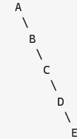
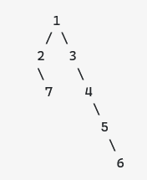
Importance:
The balance of a binary tree is governed by the property called skewness. When the binary tree becomes more skewed, then the time complexity to access an element of the binary tree increases.
Skewed Binary Tree
Imagine your tree looks like this, and the tree gets more skewed over time, then the time complexity to access an element of the binary tree increases.
Binary Tree Right Skewed
This binary tree has 7 elements. An ideal binary tree requires O(log 7) = 3 lookups. You need to go 1 more deep = 4 lookups in worst case. The skewness here is constant 1.
If the tree has thousands of nodes, then the skewness will be even more complex in that case, which is why its very important to keep the binary tree balanced.

Slide 6
This really is a matter of balancing vs the skewness. Balancing the tree makes for better search times Olog(n)) as opposed to O(n).

Slide 7
Big-O Analysis
Search in a balanced tree –
The find, insert and delete algorithms start at the tree root and a follow path down to, at worst
case, the leaf at the very lowest level. The total number of steps of these algorithms is,
therefore, the largest level of the tree, which is called the depth of the tree. The best (fastest)
running time occurs when the binary search tree is full or balanced – in which case the search
processes used by the algorithms perform like a binary search.

Slide 8
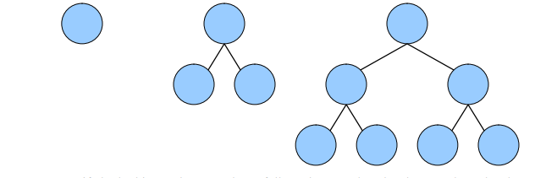
A full tree has 1 node at level 0, 2 nodes at level 1, 4 nodes at level 2 and so on. Thus, it
will have 2d nodes at level d. Adding these quantities, the total number of nodes n for a
full binary tree with depth d is:
n = 20 + 21 + 22 + … + 2d = 2d+1 − 1

Slide 9
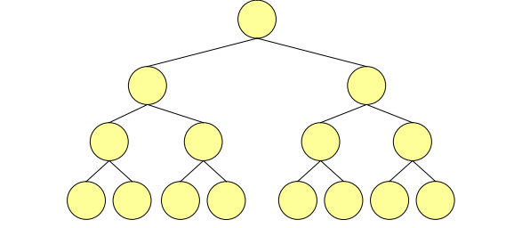
Now, considering the formula above for the number of nodes in a full binary search tree:
n = 2d+1 − 1
Solving for d, we get:
N + 1 = 2^{d+1}
lg(n + 1) = lg(2^{d+1})
lg(n + 1) = (d + 1)lg(2)
lg(n + 1) = d + 1
d = lg(n + 1) – 1
d = [lg(n)]

Slide 10
For example, the depth of a full binary search tree with 15 nodes is 3. In other words, the
depth of a binary search tree with n nodes can be no less than lg(n) and so the running
time of the find, insert and delete algorithms can be no less than lg(n). A full binary search
tree is said to be balanced because every node's proper descendants are divided evenly
between its left and right subtrees. Thus, the search algorithm employed by the find, insert
and delete operations perform like a binary search.

Slide 11
As a binary search tree becomes more and more unbalanced, the performance
of the find, insert and delete algorithms degrades until reaching the worst case of O(n),
where n is the number of nodes in the tree. For example, the number of comparisons needed
to find the node marked A in the binary search trees below is 3, which is equal to the
number of nodes.

Slide 12
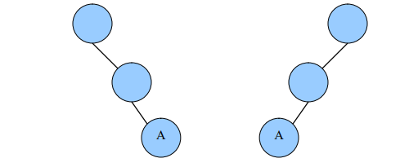
Binary search trees, such as those above, in which the nodes are in order so that
all links are to right children (or all are to left children), are called skewed trees.
The average running time of the binary search tree operations is difficult to establish
because it is not clear that all binary search trees are equally likely.1 It has been proven
that when a binary search tree is constructed through a random sequence of insertions
then the average depth of any node is O(lg n).

